Slide 1
Predictive Model for Hospital Readmission in Diabetic Patients
“Improving Care Through Risk Prediction”
Presented by:
Jean Dunac
Lawrence Onwusibe

Slide 2

Project Overview and Significance
What It Is: This project is a predictive tool that analyzes patient data to determine the likelihood of hospital readmission for individuals with diabetes. We are implementing and modifying code from GitHub user “KaushikBiswalXD” to enhance this tool, particularly the “predict.py” file.
Why It Matters: It helps healthcare professionals identify high-risk patients early and take proactive measures that improve outcomes and reduce costs.

Slide 3
Project Objectives and Operational Overview
Project Goals and Impact:
Designed to assist healthcare professionals in predicting hospital readmission risk for diabetic patients
Aims to improve patient outcomes by identifying high-risk individuals early
Helps reduce unnecessary hospital readmissions and associated costs
Translates complex health data into a clear decision-making tool
Encourages proactive healthcare through personalized feedback
How the Tool Works:
Collects patient data including age, diagnosis, lab results, diet, and medication use
Checks for critical conditions and abnormal health indicators
Calculates a cumulative risk score using predefined criteria
Categorizes BMI and includes medication adherence in the analysis
Provides a final recommendation with detailed reasoning
Outputs whether readmission is required or not

Slide 4
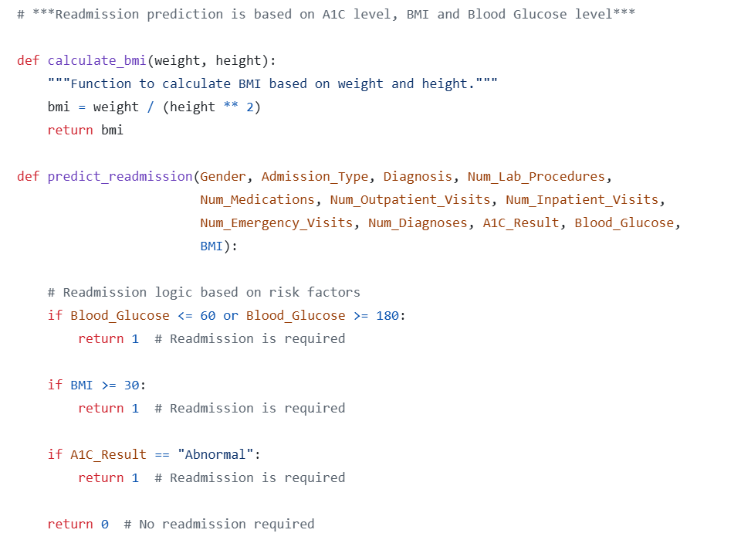
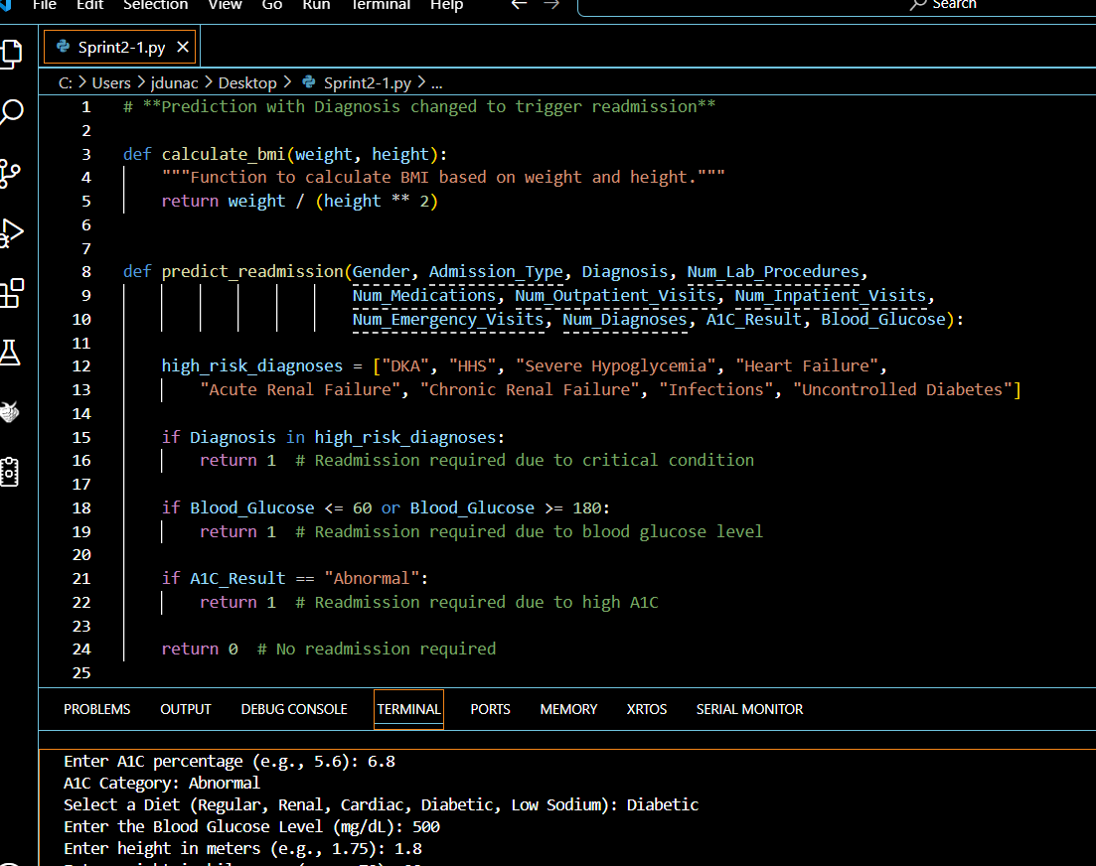
Partial Implementation of the Code

Slide 5
Credit to Original Repository
https://github.com/KaushikBiswalXD/hospital-readmission-prediction

